Slide 1


Data Governance @ SneakerPark
Prepared by:
Submitted on:

Slide 2
Background
SneakerPark is an online shoe reseller that allows people to buy and sell used and new shoes. Buyers can bid for shoes or buy them outright, and sellers can set a price or sell to the highest bidder.
Each buyer and seller must have an active account in order to sell, bid, or purchase sneakers using SneakerPark’s website.
SneakerPark authenticates the shoes before shipping them to the buyer, so before listing an item, the seller must ship it to SneakerPark’s warehouse. Upon receipt, SneakerPark assigns an item number to each pair of sneakers and notifies the seller that they are now free to list their item. If the item is not listed within 45 days, SneakerPark returns it to the seller and sends an invoice to the seller for the shipping cost.
If the item is found to be inauthentic or in an unacceptable condition, it is also returned back to the seller in a similar fashion.
When the item sells, the buyer’s account is credited with the purchase price minus the SneakerPark service fee and shipping fees to deliver the item to the buyer.
Currently, SneakerPark only supports sales within the United States.

Slide 3
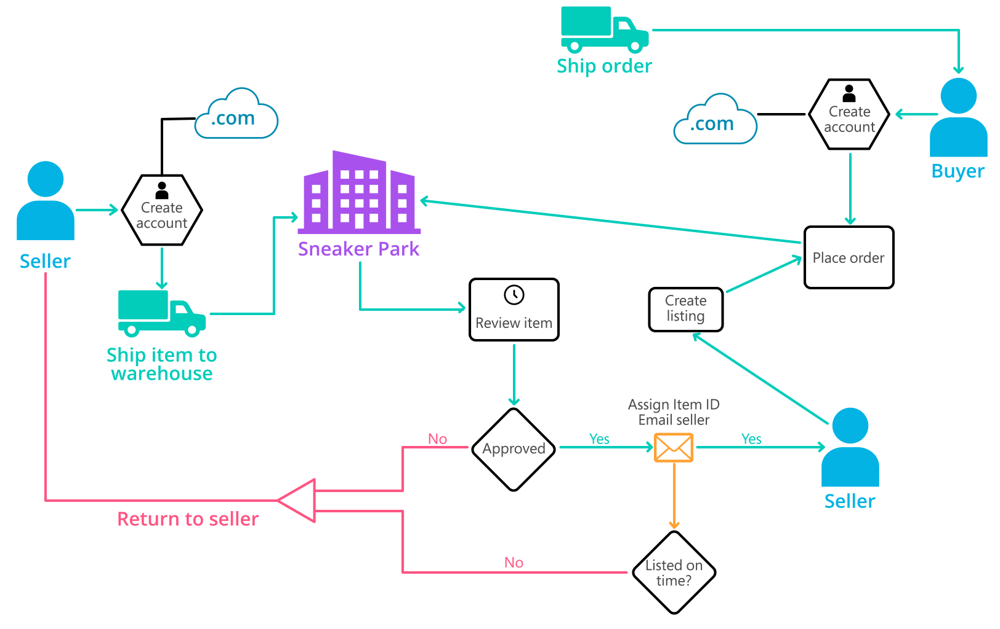
Background (cont’d)
Below you can see a diagram that will hopefully help you visualize some of SneakerPark's business processes. Keep in mind that it does not capture ALL processes and every nuance, but simply serves as another artifact to use in your project.

Slide 4
Step 1
Enterprise Data Catalog Part 1: Enterprise Data Model

Slide 5
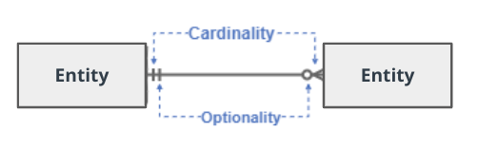
Create a conceptual data model that will provide SneakerPark with a holistic view of its data systems and help you grasp the organization's important entities and relationships, which will be instrumental as you move further in the project. You can use Lucidchart or any other diagramming tool of your choice, but please use the Crow’s Foot/IE Notation and please be sure to indicate both cardinality (the type of a relationship such as 1:N or N:N) and optionality (whether the relationship is optional or mandatory).

Slide 6
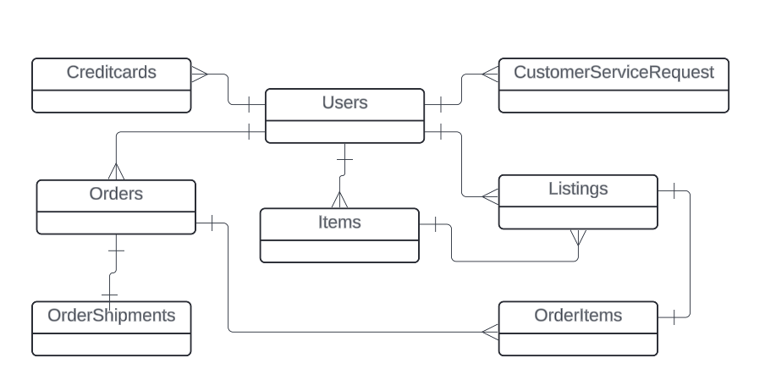
Enterprise Data Model

Slide 7
Step 2
Enterprise Data Catalog Part 2: Metadata

Slide 8
Create the first version of the Metadata Catalog by documenting the metadata from all systems in the "Data Dictionary" and the “Enterprise Data Catalog” tabs of the provided Sheets template.
Look at the excel file called sneakerpark-templates.xlsx

Slide 9
Step 3
Data Quality
Part 1: Profiling and Cleansing

Slide 10
Profile the data to identify at least 3 data quality issues you see in the data. Also provide at least 1 data quality issue that you haven’t yet seen in the data, but can foresee occurring in the future. Based on the issues you’ve identified, come up with the data quality rule for each data quality issue, including for the one that you foresee.
Make sure you fill out all columns in the "Data Quality Issues" tab with your answers in the provided Sheets template.

Slide 11
Step 4
Data Quality
Part 2: Monitoring

Slide 12
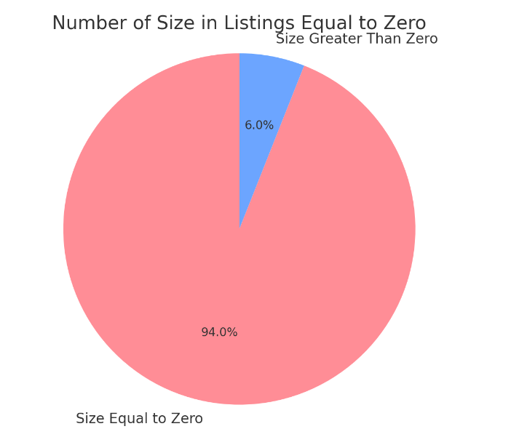
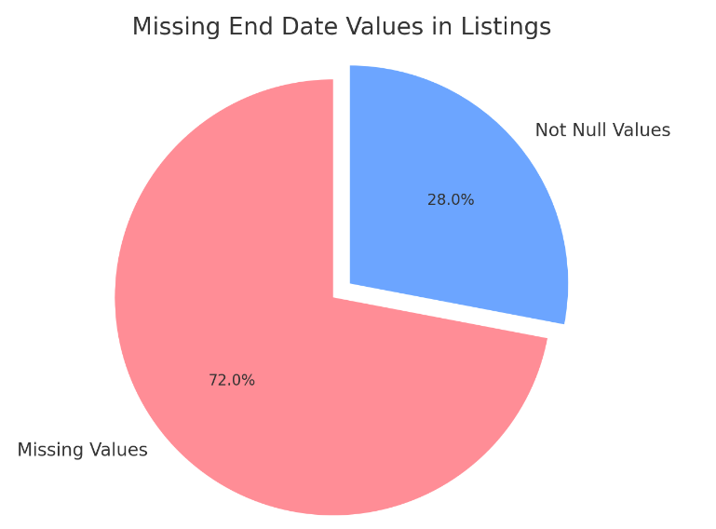
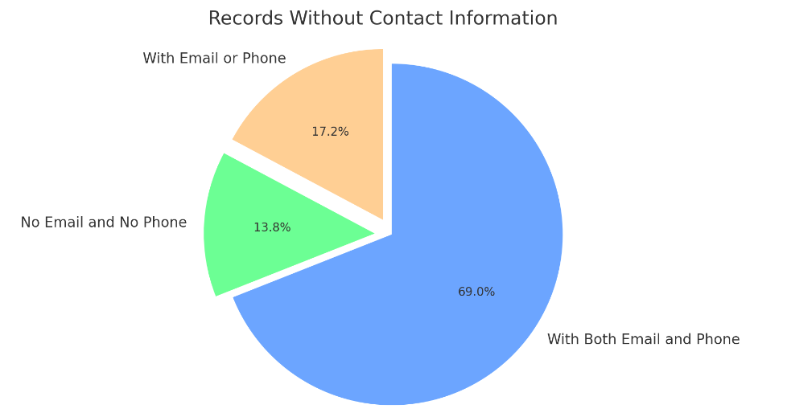
Using the metrics you've created in the last step, please create a mock-up of a data quality monitoring dashboard that will be used to monitor the data to ensure compliance with your data quality rules.

Slide 13
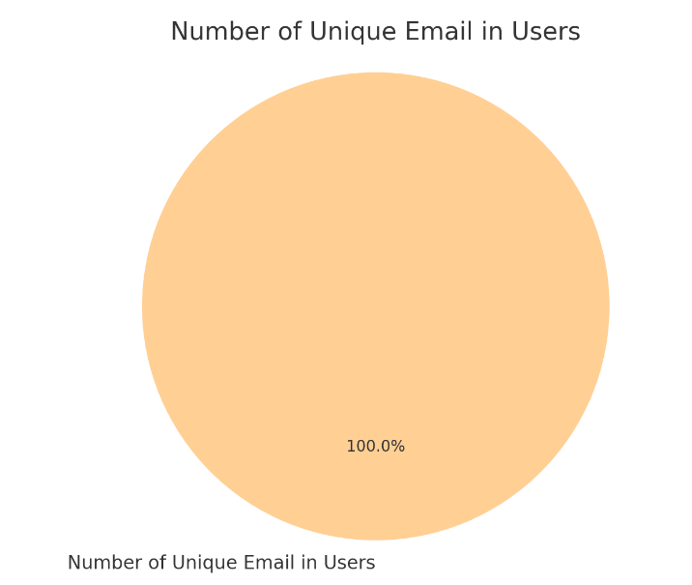
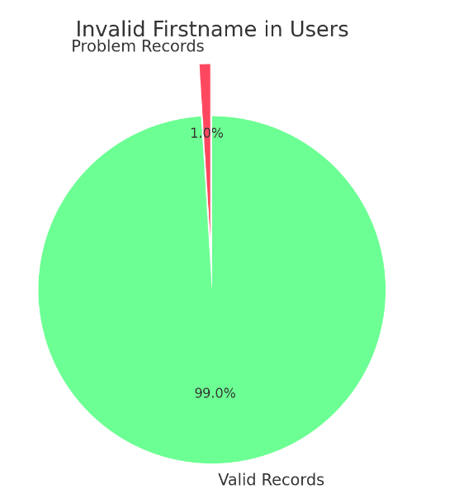
Using the metrics you've created in the last step, please create a mock-up of a data quality monitoring dashboard that will be used to monitor the data to ensure compliance with your data quality rules.

Slide 14
Step 5
Master Data Management
Part 1: MDM Architecture

Slide 15
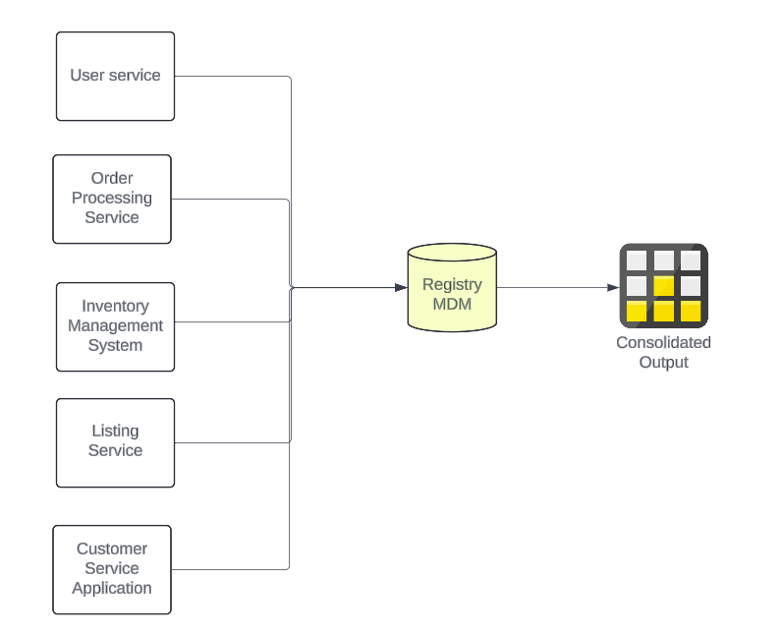
REGISTRY MDM - Diagram

Slide 16
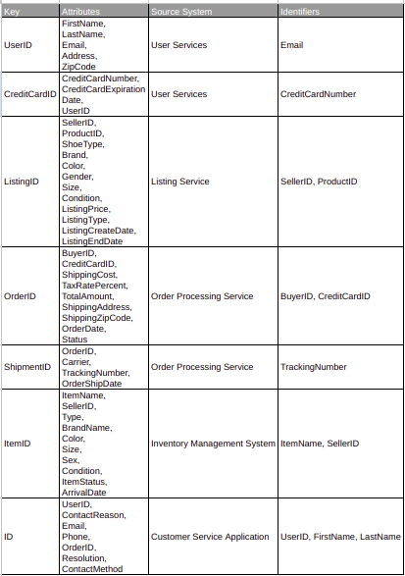
REGISTRY MDM – Table

Slide 17
Explanation:
I selected the Registry MDM architecture for our Master Data Management (MDM) program because this is the company's initial foray into investing in an Enterprise Data Management Program. The Registry MDM architecture is particularly well-suited for organizations that have not previously implemented any form of MDM architecture. Additionally, it offers the advantage of being easier to implement in future stages of our data management strategy.

Slide 18
Step 6
Master Data Management
Part 2: Master Record

Slide 19
Item Matching: Match the ItemID records based on the same ItemName and SellerID by correlating Item and SellerID from Listings.
Item Verification: For records with the same BrandName, ArrivalDate, and SellerID, match the ItemID by verifying Brand Name and Arrival Date from the Item with the Seller ID from Listings.
Customer Identification: Match the UserID records for customers with the same LastName, CreditCardNumber, and CreditCardExpirationDate by comparing LastName from Users with Credit Card details from Credit Cards.
Customer Support Queries: For issues involving the same Email and OrderID, match the UserID based on the Email from Users and the OrderID from Customer Service Requests.

Slide 20
Step 7
Data Governance:
Roles and Responsibilities

Slide 21
Data Quality Management (DQ): Ensuring high-quality data is foundational for making accurate business decisions and improving operational efficiency. SneakerPark requires a dedicated Data Steward to oversee data quality by regularly updating and validating the data against established standards and metrics. The Data Steward will also be responsible for identifying any data anomalies and initiating corrective actions. Jessica, who has deep organizational knowledge, is currently ideal for this role. However, given her existing responsibilities, augmenting her capabilities with a new hire would distribute the workload more effectively and safeguard the focus on data quality without diluting her contribution to other areas.
Master Data Management (MDM): As SneakerPark continues to expand, having a centralized system for managing master data across various business units will be vital. This system ensures that all organizational entities and departments use consistent and accurate data. A Data Architect, like Daniel Freitas, would be suitable to lead this initiative due to his extensive experience in designing data systems. Daniel's role would involve defining and implementing the MDM architecture to ensure it supports both current and future business needs, facilitating streamlined data operations and enhanced analytical capabilities.

Slide 22
Metadata Management: Managing metadata involves organizing, categorizing, and making data easier to locate and interpret by users across the enterprise. The creation of a comprehensive Metadata Management framework is essential for enhancing data accessibility and governance. SneakerPark would benefit from formalizing the role of a Metadata Manager who would be tasked with developing and maintaining an enterprise data catalog. This role could potentially be expanded within Jessica's team by bringing in additional support to specifically focus on Metadata Management, ensuring the metadata stays current and aligned with business evolution.
Currently, SneakerPark possesses foundational talent, such as Jessica in data stewardship and Daniel in data architecture, which can be pivotal in advancing these Data Governance aspects. However, the existing personnel might require support due to the breadth of responsibilities and the technical depth required in each area. Investing in additional specialized roles or training current employees, like considering reskilling or upskilling opportunities, would be prudent to meet the growing and evolving data governance needs effectively.

Slide 23
Data Steward: The Data Steward should be responsible for maintaining the data dictionary's business context within SneakerPark's Metadata Management. This includes updating entries due to new additions (such as tables or columns) and changes in business descriptions. Jessica is well-suited for this role given her comprehensive understanding of all organizational parts. To help manage her workload, due to her other responsibilities, it might be beneficial to hire a new employee to assist Jessica.
Data Architecture: The role involves defining the workflows for Data Quality Management and Metrics, as well as the architecture for Master Data Management across the system. The aim is to develop automated and intelligent methods for identifying data breaches and quality issues. Daniel Freitas, with his extensive experience in building platforms, is ideal for this role.
Data Engineer: Focused on ProdOps, the Data Engineer will provide IT production support for both Data Quality Management and Master Data Management. Effective production support is crucial to maintain the consistency, accuracy, and timeliness of data. Jake is recommended for this role, given his qualifications and experience.

